Slide 1



Neurodivergence in the Criminal Justice System
Caoilainn Christensen Mentored by Dr. Anne Perrotti
Research Experience for Undergraduates in Disinformation Detection and Analytics
@caoilainnsc

Slide 2
How do the experiences of neurodivergent individuals differ from those of neurotypical individuals in the American criminal justice system ?
@caoilainnsc

Slide 3
Key Terms/Abbreviations
ASD
Autism Spectrum Disorder
Neurodivergence
ADHD
Attention Deficit-Hyperactivity Disorder
ASD
Dyslexia
ND/NT
Neurodivergent/Neurotypical
ADHD
CJS
Criminal Justice System
@caoilainnsc

Slide 4
Gap in Literature
Current work mostly focuses on each disability under ND individually, not ND as a whole
The work done in the United States is lacking compared to research in the Europe (especially the UK)
No existing overall analysis of the experience of ND individuals in the American CJS
@caoilainnsc

Slide 5
Methodology
01
02
Gathering literature
Analyzing Metadata
Using Google Scholar and current sources' reference lists to find relevant papers
Discovering trends in time period and category of the papers
03
04
Cluster Analysis
Discussion of Data
Rewriting code to process the documents and identify themes in the text
Using the collected data to find the overall differences in experiences
@caoilainnsc

Slide 6
Gathering Literature
Neurodivergence
Neurodivergence criminal justice system
Google Scholar Search
ASD
Autism criminal justice system
Hand Search
ADHD
Went through each articles references for any additional relevant articles
Any article that was about the disorder in the context of the CJS, and was published in the United States
ADHD criminal justice system
Dyslexia
Dyslexia criminal justice system
@caoilainnsc

Slide 7
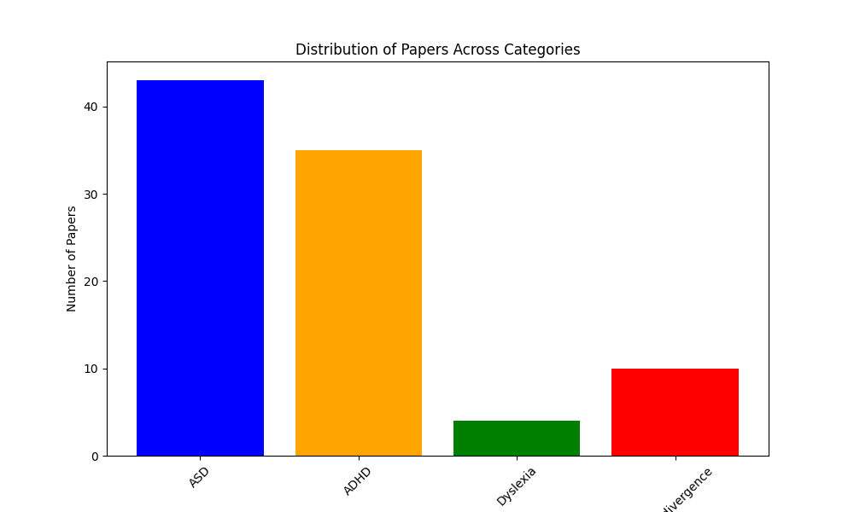
Metadata
@caoilainnsc

Slide 8
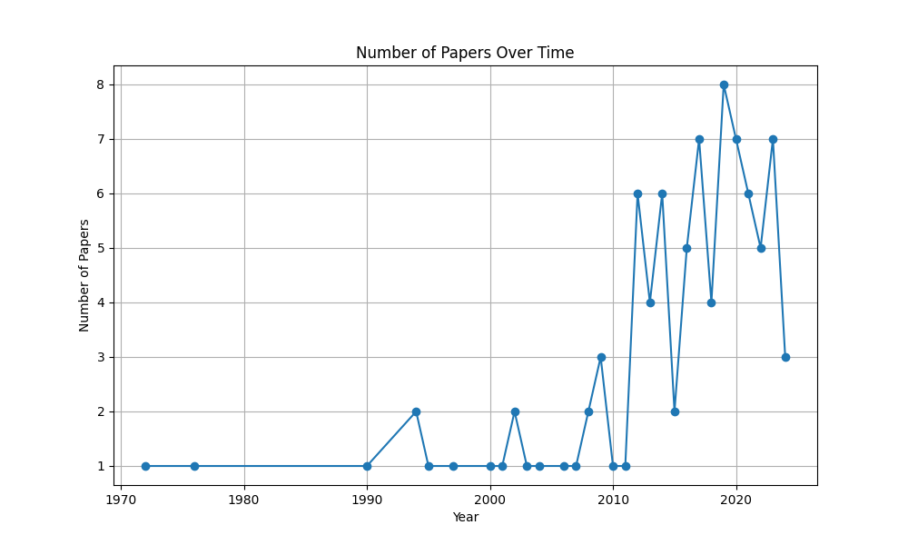
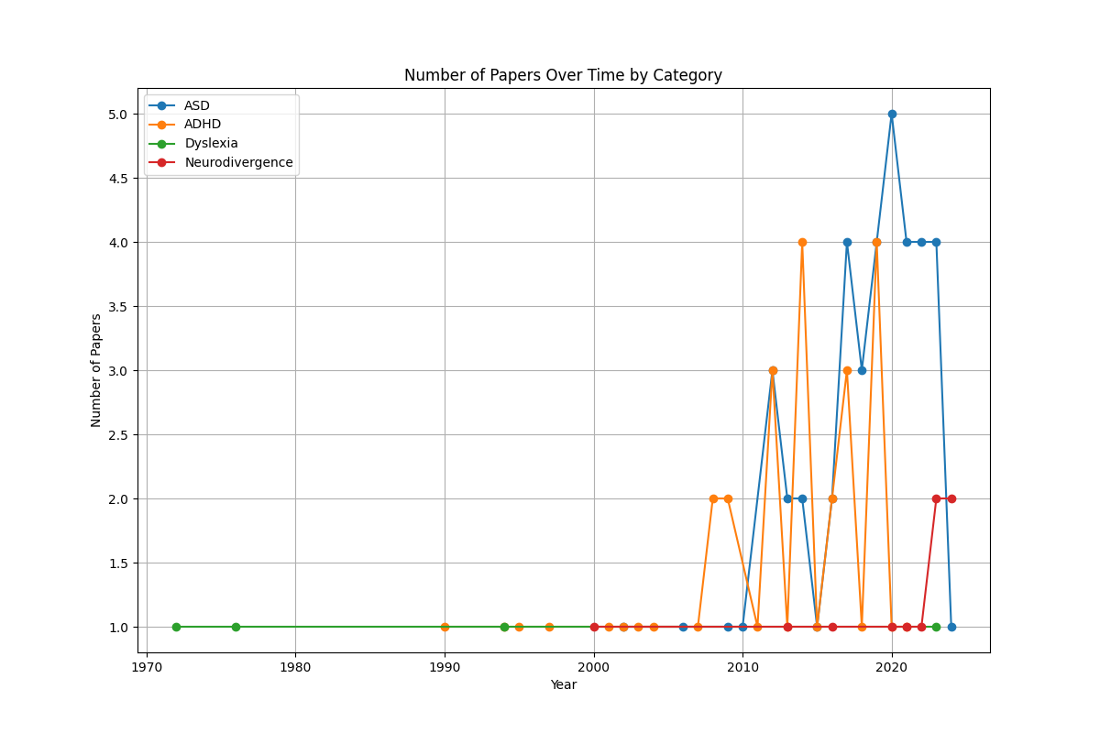
Metadata
@caoilainnsc

Slide 9
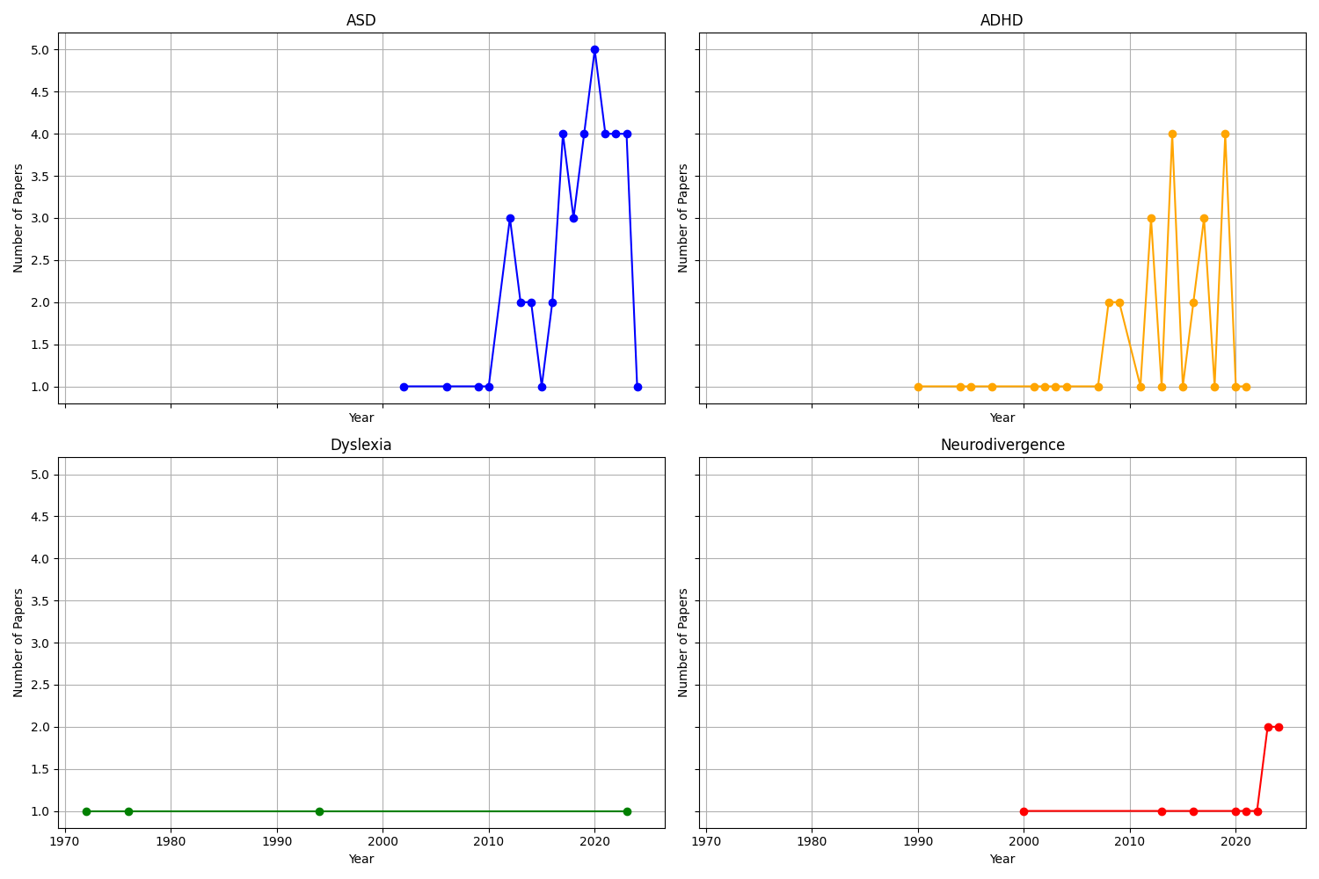
Metadata
@caoilainnsc

Slide 10
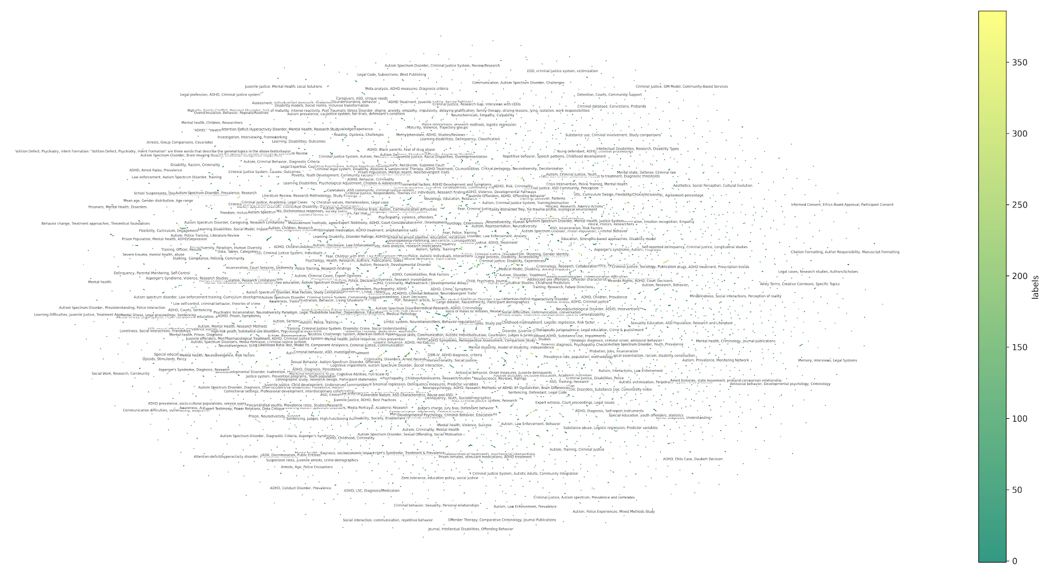
Results - Text Clustering
@caoilainnsc

Slide 11

Results - Text Clustering
Fear, Police, Training
Learning Disability, Disorder Ratings, ADHD/CD/ODD Risks
School-to-Prison Pipeline, Education, Recidivism
Autism, Police, Fear/Autism Spectrum Disorder, Law Enforcement, Anxiety
Developmental Parenting, Self-Control, Consequences
Probation, School Discipline, Delinquency
Criminal Justice, ADHD, Treatment
Autism, Disclosure, Law Enforcement
ADHD, Children/Adolescents, Treatment/Assessment/Diagnosis
Limited Study, Data Analysis, Research Implications
Autism, Safety, Training
@caoilainnsc

Slide 12

Results - Text Clustering
Drug Courts, Recidivism, Supreme Court
Legal Expertise, Cognitive Functioning, Autism Spectrum Disorder
Criminal Legal System, Disability, Ableism & Sanism
Behavioral Therapy, ADHD Treatment, Comorbidities
Prison Population, Mental Health, Neurodivergent Traits
Prisoners, ADHD, Prevalence
Poverty, Youth Development, Community Factors
ADHD, Behavior, Criminality
@caoilainnsc

Slide 13

Results - Text Clustering
Autism, Sentencing, Mitigating Factors
Autism, Police, Training
Training, Criminal Justice System, Diversity: Crime, Social Understanding
High-Risk Youth, Substance Use Disorders, Psychological Evaluation
Attention Disorder, Medication, Heritability
Nicotinic Cholinergic System, Attention Deficit Hyperactivity Disorder, Treatment and Diagnosis
Autism, Representation, Neurodiversity
Social Skills, Communication, Autistic Individuals
Pharmacological Treatment, ADHD, Criminal Justice System
Mental Health, Police Response, Crisis Prevention
Autism, Criminal Justice, Rehabilitation
Genetic Influence, ADHD, Heritability
ADHD Symptoms, Retrospective Assessment, Comparison Study
Autistic Spectrum Disorders, Media Portrayal, Criminal Justice System
Neurodivergence, Special Education, Disability Studies
Log-Likelihood Ratio Test, Model Fit, Component Analysis
Autism, Criminal Justice, Communication
@caoilainnsc

Slide 14
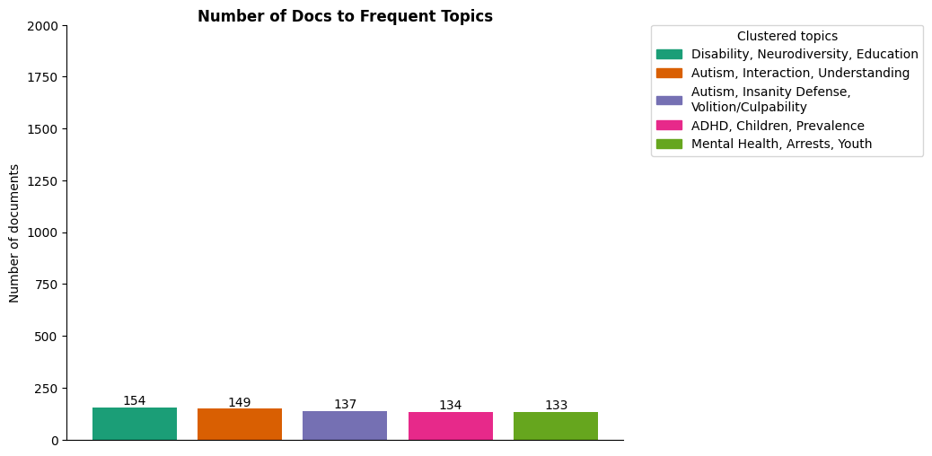
Results - Frequently Discussed Topics
@caoilainnsc

Slide 15
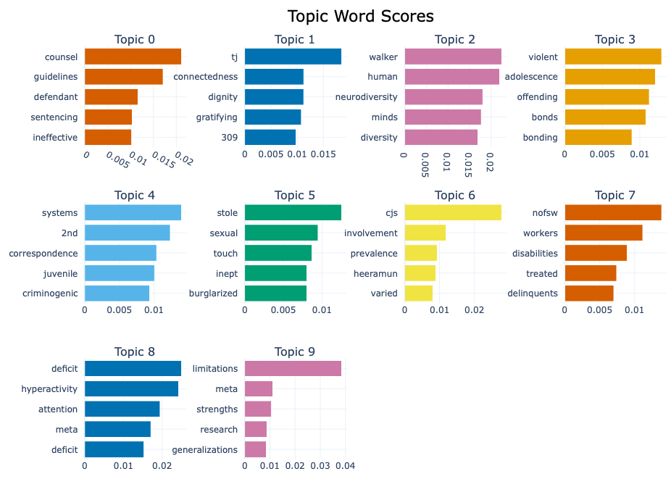
Results - BERTopic
Topic 0: outcomes and assistance in CJS
Topic 1: comfort/ND experience
Topic 2: difference in perspective
Topic 3: bond/violence
Topic 4: CJS
Topic 5: type of crime/culpability
Topic 6: prevalence/difference in experience
Topic 7: treatment for disabilities
Topic 8: ADHD
Topic 9: research words from the paper
@caoilainnsc

Slide 16
Discussion/Conclusion and Future Direction
Lack of US Research on ND in CJS
Main Themes Emerged
Educational and parental influence
Bias/lack of training in police and CJS decision makers
Understanding culpability
This project aims to bridge the gap in research by gathering existing literature for analysis
Limitations
Future Direction
The results from some of the analyses were hard to interpret because of noise and there were overall too many clusters from text clustering to analyze properly
This project can be improved upon by creating a more accurate and useful analysis, but the information can also be useful in providing directions for research on the disadvantages for ND individuals in the CJS
@caoilainnsc

